Slide 1
Factors influence
the number of people living in a household
Team 2
Team member: Desheng Guo, Fengkai YU, Xunke DENG,
Chengcheng Zheng, Panthakan Boonsuriyatham

Slide 2
PART 01
Introduction

Slide 3

1
Research Question
Introduction
2
Research
Approach
3
Data
Collection
4
Data
Analyze

Slide 4
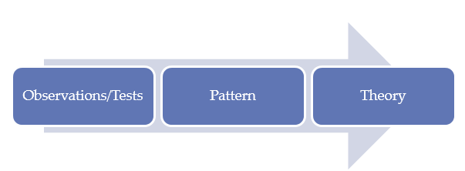
Research Question
Inductive
Research Approach
Which household related variables influence
the number of people living in a household?

Slide 5
FIES (Family Income and Expenditure Survey)
Recorded in MIMAROPA of the Philippines.
1249 samples with 11 variables
· Total.Household.Income is the Annual household income (in Philippine peso)
· Region is the region of the Philippines which a household is in
· Total.Food.Expenditure is the annual expenditure by the household on food
(in Philippine peso)
· Household.Head.Sex is the head of the households sex
· Household.Head.Age is the head of the households age (in years)
· Type.of.Household is the relationship between the group of people living in the house
· Total.Number.of.Family.members is the number of people living in the house
· House.Floor.Area is the floor area of the house (in square meter)
· House.Age is the age of the building (in years)
· Number.of.bedrooms is the number of bedrooms in the house
· Electricity is the electricity status of the house (1=Yes, 0=No)
where “head of the household” is the person who is in charge of that house.
Data
Collection
Generalized Linear Model
(GLM)
Data Analyze

Slide 6
PART 02
Exploratory Data Analysis

Slide 7
Statistics Summary
Summary statistics of continuous variables
Variable | Mean | SD | Min | Median | Max | IQR
Total.Number.of.Family.members | 4 | 2 | 1 | 4 | 16 | 2
Total.Household.Income | 216,685 | 263,207 | 18,784 | 140,483 | 2,891,788 | 89,919
Total.Food.Expenditure | 70,760 | 41,638 | 10,488 | 62,590 | 413,844 | 24,118
Household.Head.Age | 51 | 14 | 15 | 51 | 87 | 10
House.Floor.Area | 49 | 49 | 5 | 36 | 750 | 24
House.Age | 16 | 13 | 0 | 14 | 105 | 8
Number.of.bedrooms | 2 | 1 | 0 | 2 | 7 | 0
Summary statistics of discrete variables
Variable | Counts
Household.Head.Sex | Mal: 983, Fem: 266
Type.of.Household | Sin: 900, Ext: 344, Two: 5
Electricity | 1: 1069, 0: 180

Slide 8
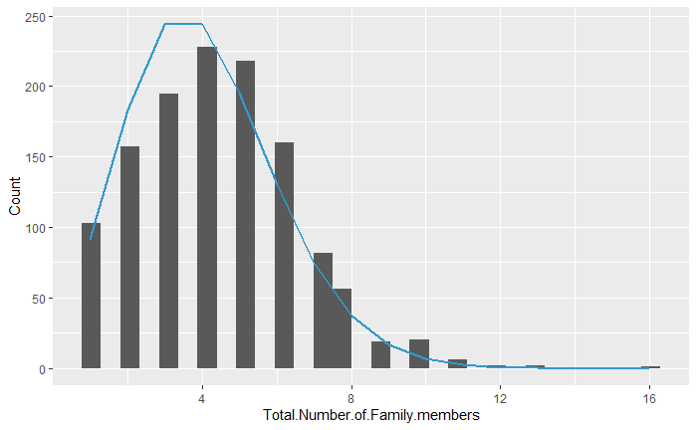
Distribution of Total.Number.of.Family.members
The distribution of number of family members follows
Poisson distribution.
Note:
The blue line is the standard Poisson distribution whose mean equals 4.
The bar is the distribution of Total.Number.of.Family.members.

Slide 9
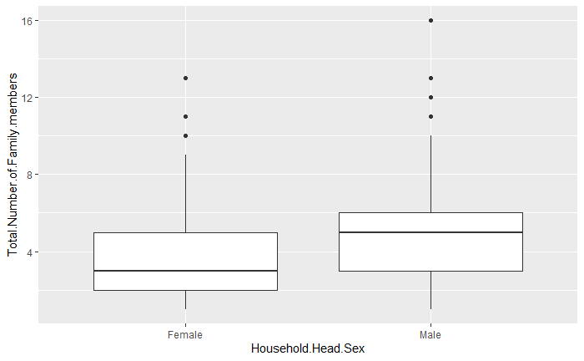
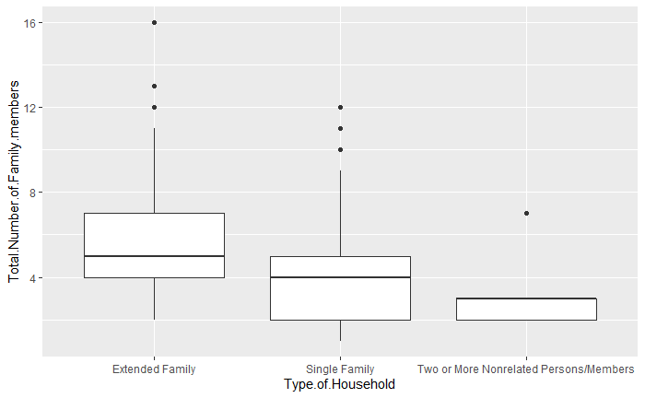
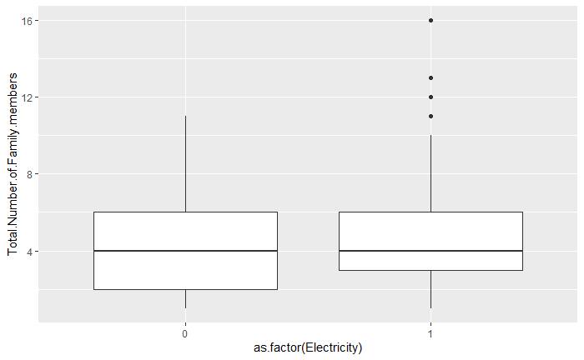
Analysis of Features
1.On average, male head families have more members than female.
2. Extended Families have more members than single families and single families have more members than nonrelated persons families.
3. Electricity has no impact on the numbers of members in each family.

Slide 10
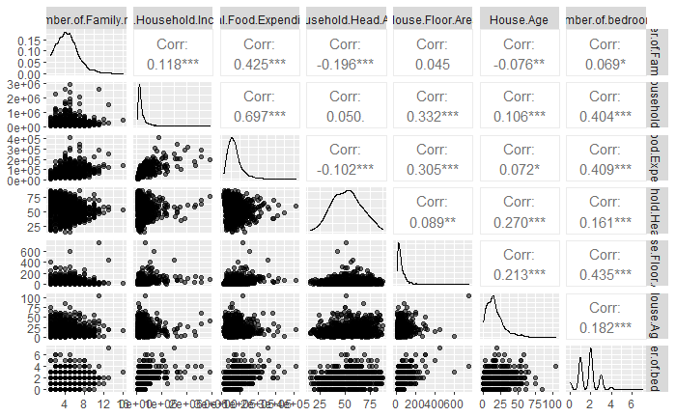
Analysis of Features
Weak or very weak correlation
Weak or even no linear relationship
Except income and expenditure (moderate positive correlation), other features only have weak or very weak correlation.
No multicollinearity

Slide 11
PART 03
Modeling and Results

Slide 12
Model Assumption
1. The human time risk of different objects with the same characteristics and at the same time is homogeneous.
2. When the sample size is larger and larger, the mean of frequency tends to variance.

Slide 13
Preliminary fitting model
Model <- glm( Total.Number.of.Family.members ~ Total.Household.Income + Total.Food.Expenditure + Household.Head.Sex + Household.Head.Age + Type.of.Household + House.Floor.Area + House.Age + Number.of.bedrooms + Electricity,
data=data, family = "poisson“)

Slide 14
Model Optimization Process
Step wise & Drop Outlier
Best Model
After we use logarithm transformation, we repeat step wise and dropping outlier again. Finally, we get our best model whose AIC is 4795.
Preliminary model
Logarithm Transform
Step wise
Drop Outlier
Because “Total.Household.Income” and “Total.Food.Expenditure” are too large, their coefficients are too close to 1. It is impossible to know whether the interval contains 1, that is, whether the variable is significant. So we use logarithm transform.
“House.Floor.Area”, “Electricity” are dropped out. AIC decreases from 4932 to 4930.
One outlier is detected whose “Total.Food.Expenditure” is much higher than other samples. AIC decreases from 4930 to 4901.

Slide 15
Best Model
model.best<-glm(Total.Number.of.Family.members~log(Total.Household.Income) + log(Total.Food.Expenditure) + Household.Head.Sex + Household.Head.Age + Type.of.Household + House.Age + Number.of.bedrooms + Electricity,
data=data, family = "poisson")

Slide 16
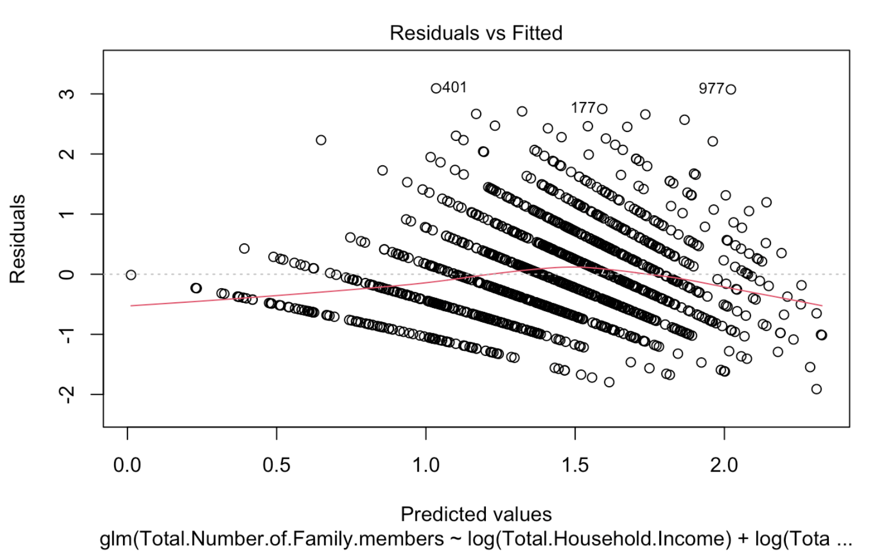
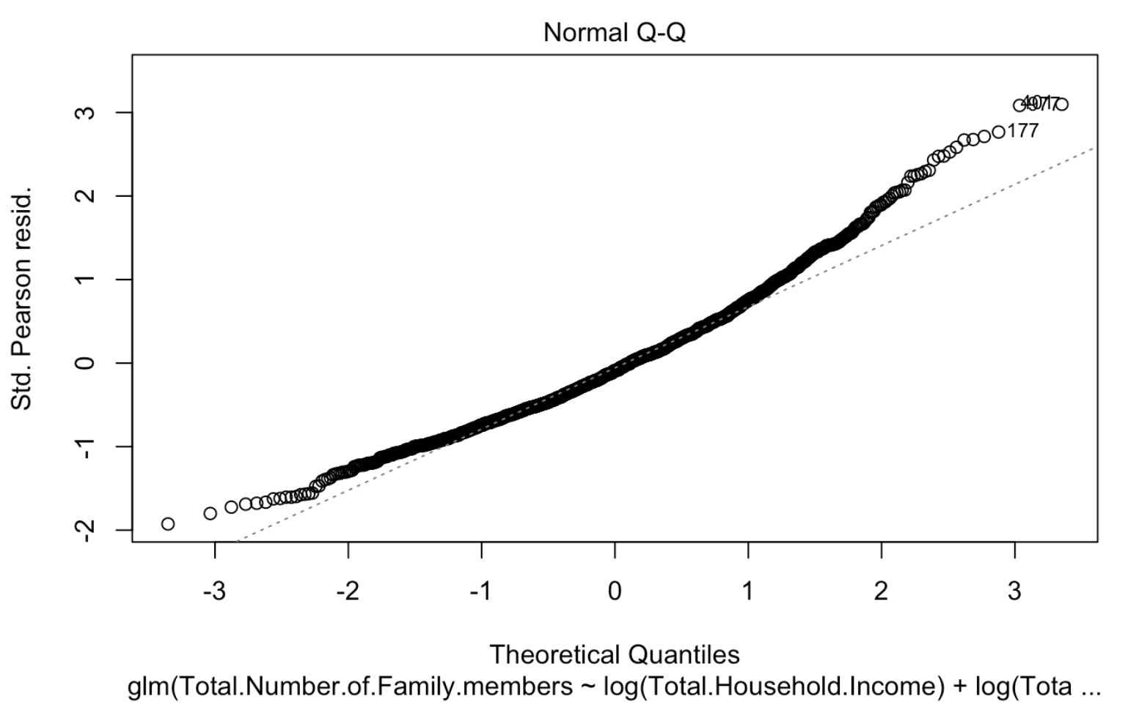
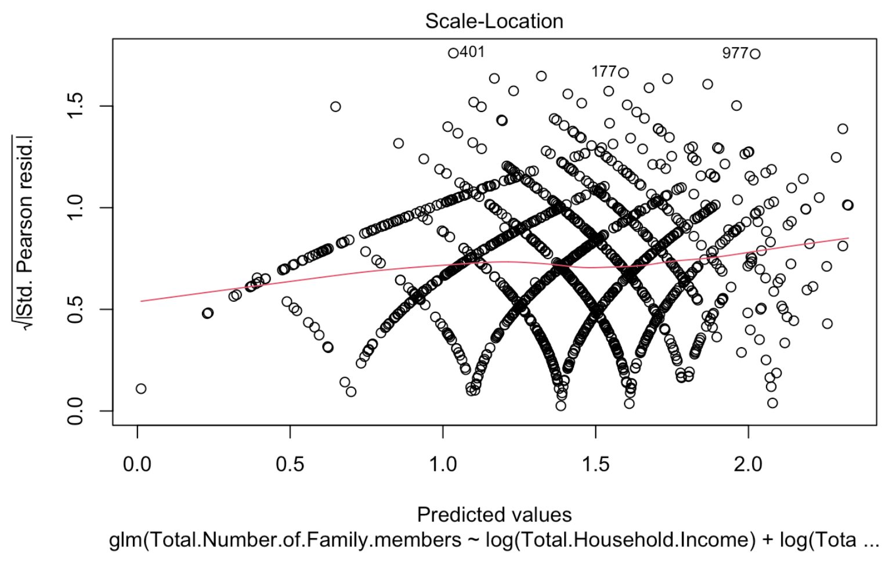
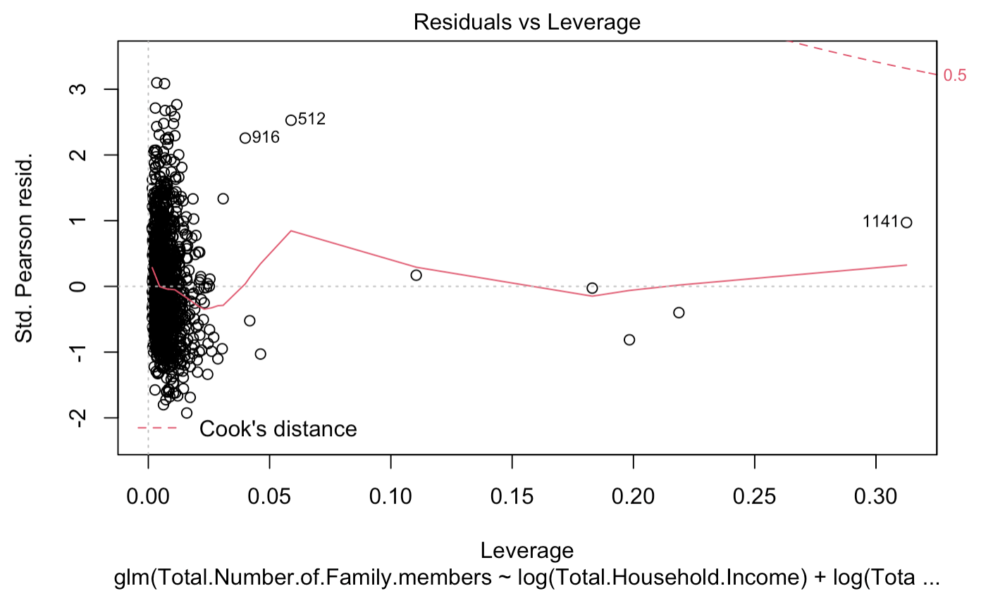
Assumption Checking

Slide 17
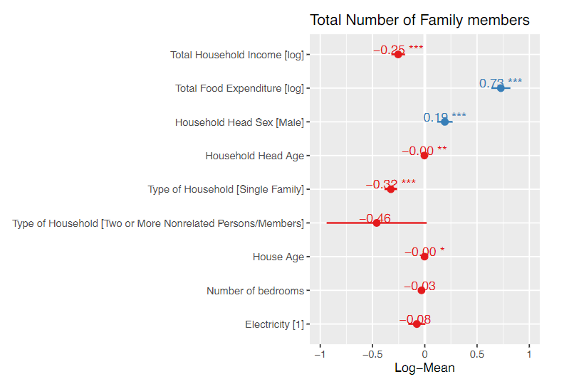
Coefficient and Interpretation
Parameter | Exp(coef)
Intercept | 0.043
log(Total.Household.Income) | 0.776
log(Total.Food.Expenditure) | 2.070
Household.Head.SexMale | 1.211
Household.Head.Age | 0.997
Type.of.HouseholdSingle Family | 0.723
Type.of.HouseholdTwo or More Nonrelated Persons/Members | 0.631
House.Age | 0.998
Number.of.bedrooms | 0.969
Electricity1 | 0.927
Exp(coef)

Slide 18
PART 04
Conclusion and Future Work

Slide 19
Conclusions
Positive
Impactions
Negative
Impactions
log(Total.Household.Income)
Type.of.HouseholdSingle Family
Type.of.HouseholdTwo or More Nonrelated Persons/Members
Number.of.bedrooms
Electricity1
log(Total.Food.Expenditure)
(the biggest impaction)
Household.Head.SexMale

Slide 20
Future Work
Larger Sample Size
Shorter Sample Period
Sampling each three year
Sampling each year
Sampling in
MIMAROPA
Sampling among Philippine

Slide 21
THANK
YOU

